Slide 1
Unity Sound
CSCI 4160U – Interactive Media
Isaiah von Uders

Slide 2
Sound in Unity
In unity, we can create objects of sound that can be played during runtime of our game.
This can be useful for the following examples:
Sound effects
Background music
Voice acting
And more!

Slide 3
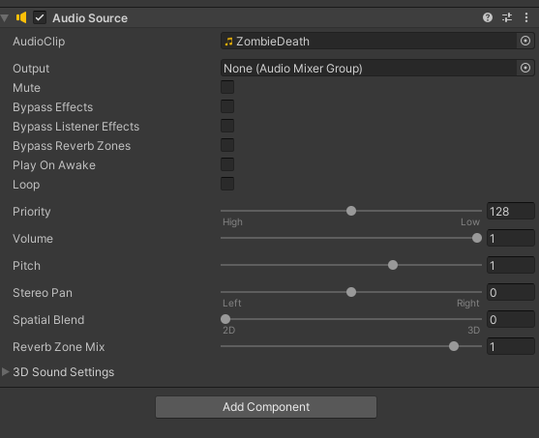
Sound in Unity – Unity Editor
When dragging a sound in to our scene, in the unity editor we have the following options:
The most important setting is “Play On Awake” setting. As if we have sound effects that we want to play at a specific moment, we don’t want them to always play when the game initially starts.
We can also adjust specific settings, such as Loop (useful for music) and the volume settings!

Slide 4


Sound in Unity – Unity Editor
We can reference our sound files as AudioSource when coding.
If we want our sound to play at a specific moment in the code, we can simply do SoundEffect.Play()
Additionally, if we want to prevent playing the audio on awake, we can also do that with code.

Slide 5
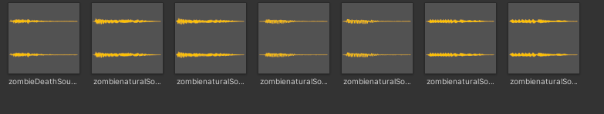
Sound in Unity – Creating Sounds
In unity, any audio file is accepted!
MP3
WAV
And more!
For creating sound effects or music, we can use free assets, or make our own with free audio editing software (e.g. audacity – www.audacityteam.org)

Slide 6
Sound in Unity – Learning More
For more on sound in unity, here are some sources:
Introduction to AUDIO in Unity – YouTube
Unity - Manual: Audio Source (unity3d.com)
Unity - Manual: Audio Overview (unity3d.com)

